Slide 1



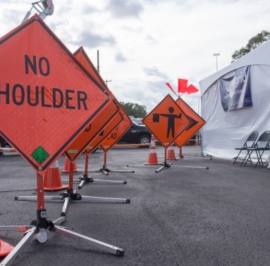
Direct From The Heart Of A Co-op
Ojas Phansekar

Slide 2
Induction
Introduction to team members
One-on-One interactions with each team member
Introduction to the project by Nicolas Raad
Access to different systems
Knowing individual contributions to the team
Notes:
Discovered my learning areas and interest after getting to know the entire team and how they function

Slide 3
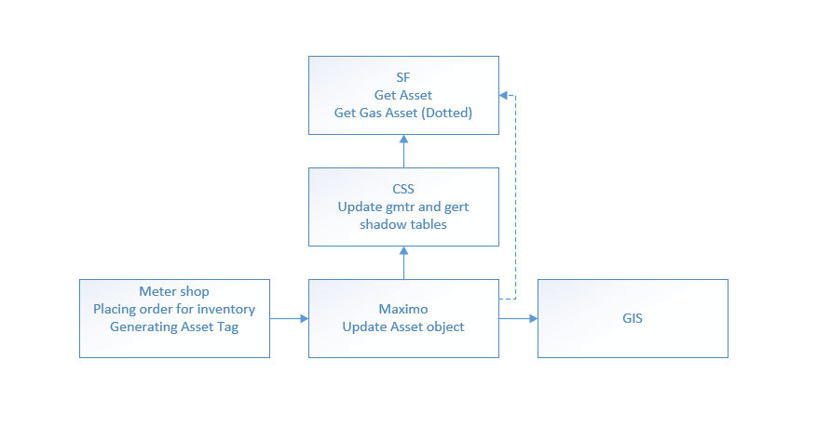
Kick Start
First Major Assignment Data Flows

Slide 4
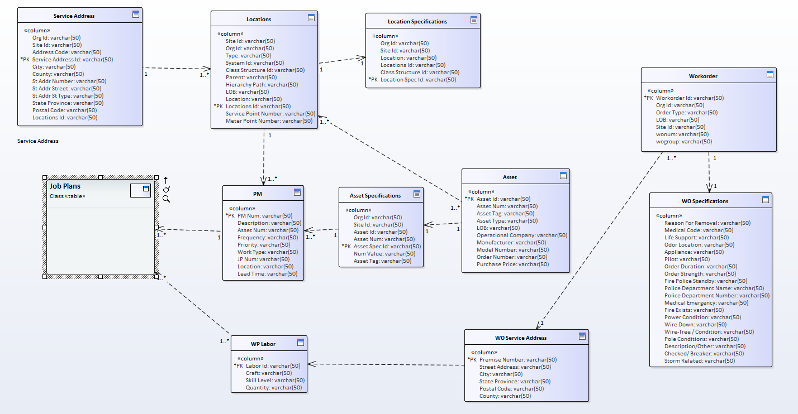
Data Model On Sparx Enterprise Architecture

Slide 5
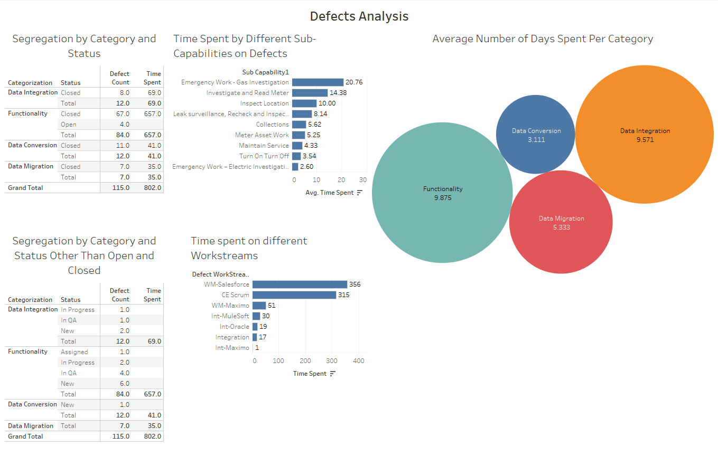
Project – Defect Analysis
Notes:
In this task we had to identify the average time taken for a defect to be closed in ALM and number of defects causing delays because of Data Management Team

Slide 6
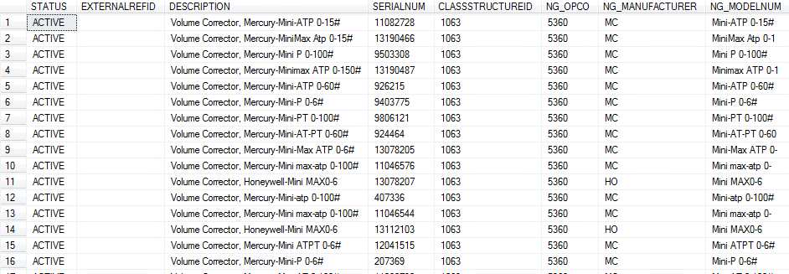
Data Validation / Data Accuracy / Testing
PA 2.3 Cutover
External Ref Ids are missing and Pwc(ERIC) is raising a low priority for it
select [STATUS],
[EXTERNALREFID],
[DESCRIPTION],
[SERIALNUM],
--[INSTALLDATE],
[CLASSSTRUCTUREID],
[NG_OPCO],
[NG_MANUFACTURER],
[NG_MODELNUM]
from [MX].[asset_recon]
where GROUPNAME like 'NG_VCMTRS'

Slide 7
Data Validation / Data Accuracy / Testing
PA 2.3 Cutover
Manufacturer field is null in the Source table VWRI_Volume_Corrector_RI and it is blank in Target table
Source Table
Target Table

Slide 8
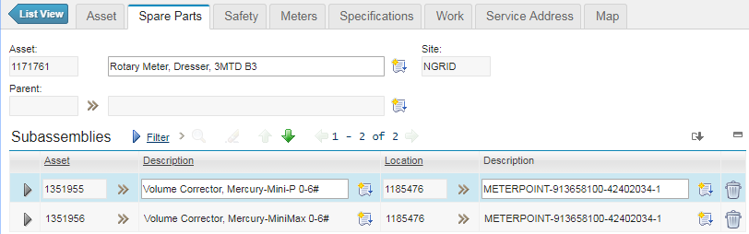
Data Validation / Data Accuracy / Testing
PA 2.3 Cutover
Wrong Scenario Detected :
One Meter can have multiple Volume Correctors
Checked the hierarchy like having appropriate volume correctors tied to the meters
1171761, 1173123 Asset Numbers have multiple Volume Correctors

Slide 9
Data Validation / Data Accuracy / Testing
PA 2.3 Cutover
Query capturing Multiple Volume Correctors for One Meter
Select A.ASSETNUM
,A.LOCATION
,B.PARENT
,VCV.vc_status
,VCV.DESCRIPTION
,VCV.evc_no
,VCV.CLASSSTRUCTUREID
,VCV.NG_OPCO
,VCV.MANUFACTURER,
VCV.evc_type
FROM [Volume_Correctors].[VWRI_Volume_Corrector_RI] VCV
LEFT JOIN [MX].[asset_recon] A ON
VCV.[PARENT_EXTERNALREFID] = A.EXTERNALREFID
LEFT JOIN [MX].[asset_recon] B ON
A.ASSETNUM = B.PARENT AND
B.NG_EQTYPE = 'VC'

Slide 10
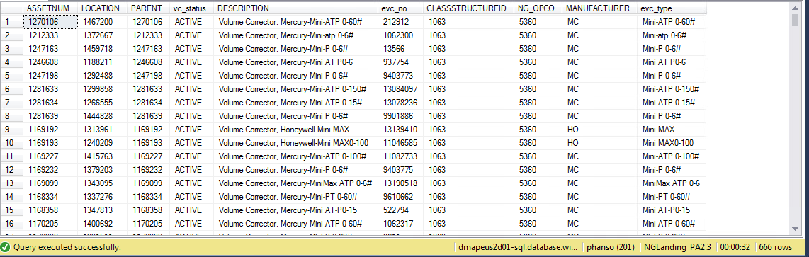
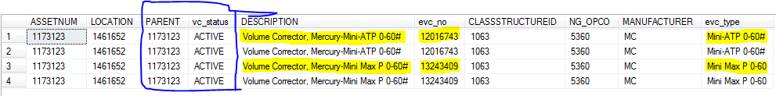
Data Validation / Data Accuracy / Testing
PA 2.3 Cutover

Slide 11
Data Validation / Data Accuracy / Testing
PA 2.3 Mock 3 & Cutover
Built SQL Queries to create a customized view of the columns from various tables using joins and then navigated on to Salesforce UAT Environment and validated data for each Customer (Residential and Commercial), Billing Account and Premise Profile
Below are the few queries which I built by joining various tables following the get calls document

Slide 12
Data Validation / Data Accuracy / Testing
/****** Customer Profile ******/
SELECT SAD.[KY_CUST_NO]
,SAD.[NM_COMPRESSED]
,SAD.[NM_CUST_1ST_1]
,SAD.[NM_CUST_MID_1]
,SAD.[NM_CUST_LST_1]
,Cust.[TX_HOME_ACD]
,Cust.[TX_HOME_PHN_NO]
,Cust.[TX_HOME_PHN_EXTN]
,Cust.[TX_BUS_ACD]
,Cust.[TX_BUS_PHN_NO]
,Cust.[TX_BUS_PHN_EXTN]
,Cust.[CD_CUST_TYPE]
,demo.[DT_CUST_BIRTH]
,SAD.[KY_SSN]
,adr.[AD_LN]
,bacustcr.[DT_TEMP_MAIL_END]
,bacustcr.[DT_TEMP_MAIL_START]
,Cust.[NO_LOCK_SEQ_CUST]
FROM [CSS].[CU01TB01_SAD] as SAD
inner join [CSS].[CU03TB01_CUSTOMER] as Cust
on SAD.[KY_CUST_NO] = Cust.[KY_CUST_NO]
inner join [CSS].[CU03TB19_CUST_DEMO] as demo
on Cust.[KY_CUST_NO] = demo.[KY_CUST_NO]
inner join [CSS].[CU02TB02_ADDRESSES] as adr
on SAD.[KY_AD] = adr.[KY_AD]
inner join [CSS].[CU03TB07_BACUSTCR] as bacustcr
on SAD.[KY_BA] = bacustcr.[KY_BA]
where SAD.[KY_CUST_NO] = 866002791
Here we need to actually look into the mapping document and spot check by applying joins .
Mapping Documents helped me understand the conversions taken place for various fields

Slide 13
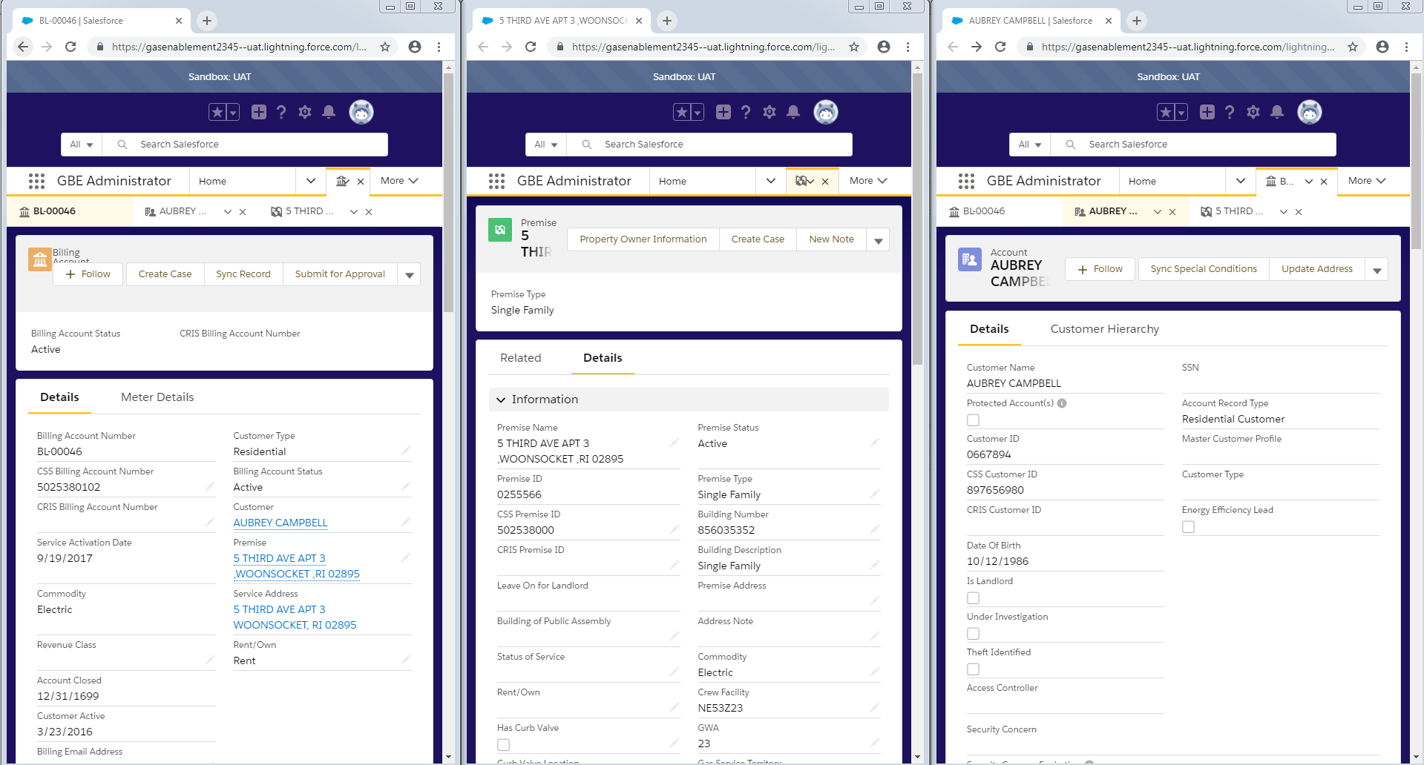
Data Validation / Data Accuracy / Testing
Screenshots of Validations Performed:

Slide 14
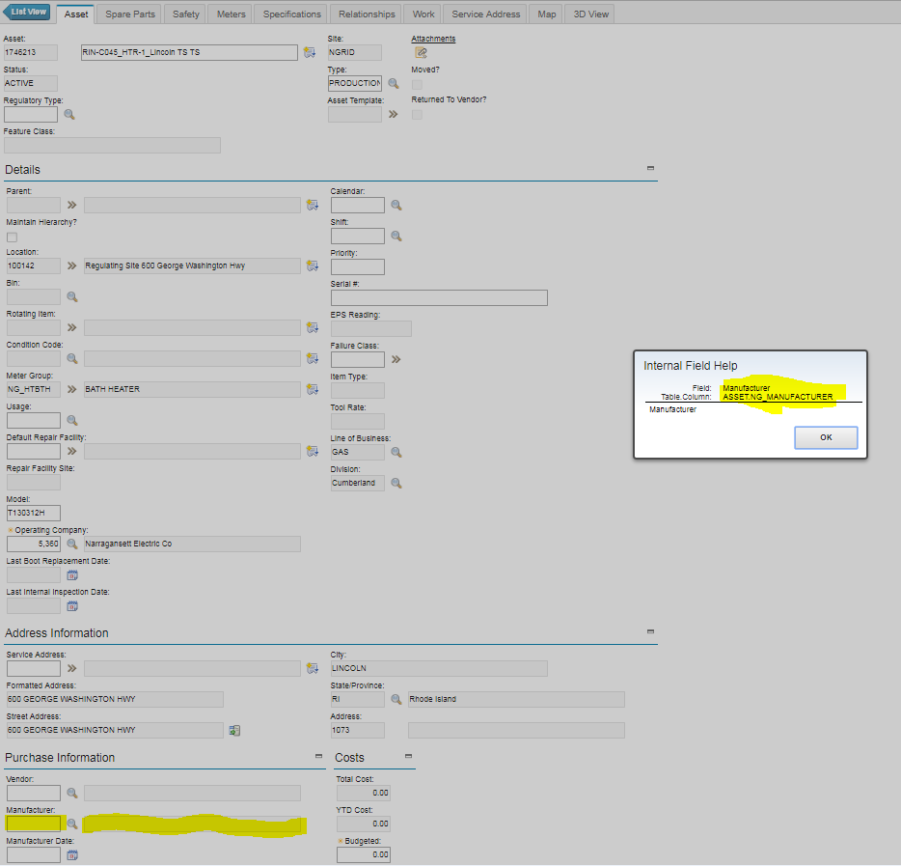
Data Validation / Data Accuracy / Testing
PA 2.3 Mock 3 I&R Assets
Target Maximo
Source NG_Landing

Slide 15
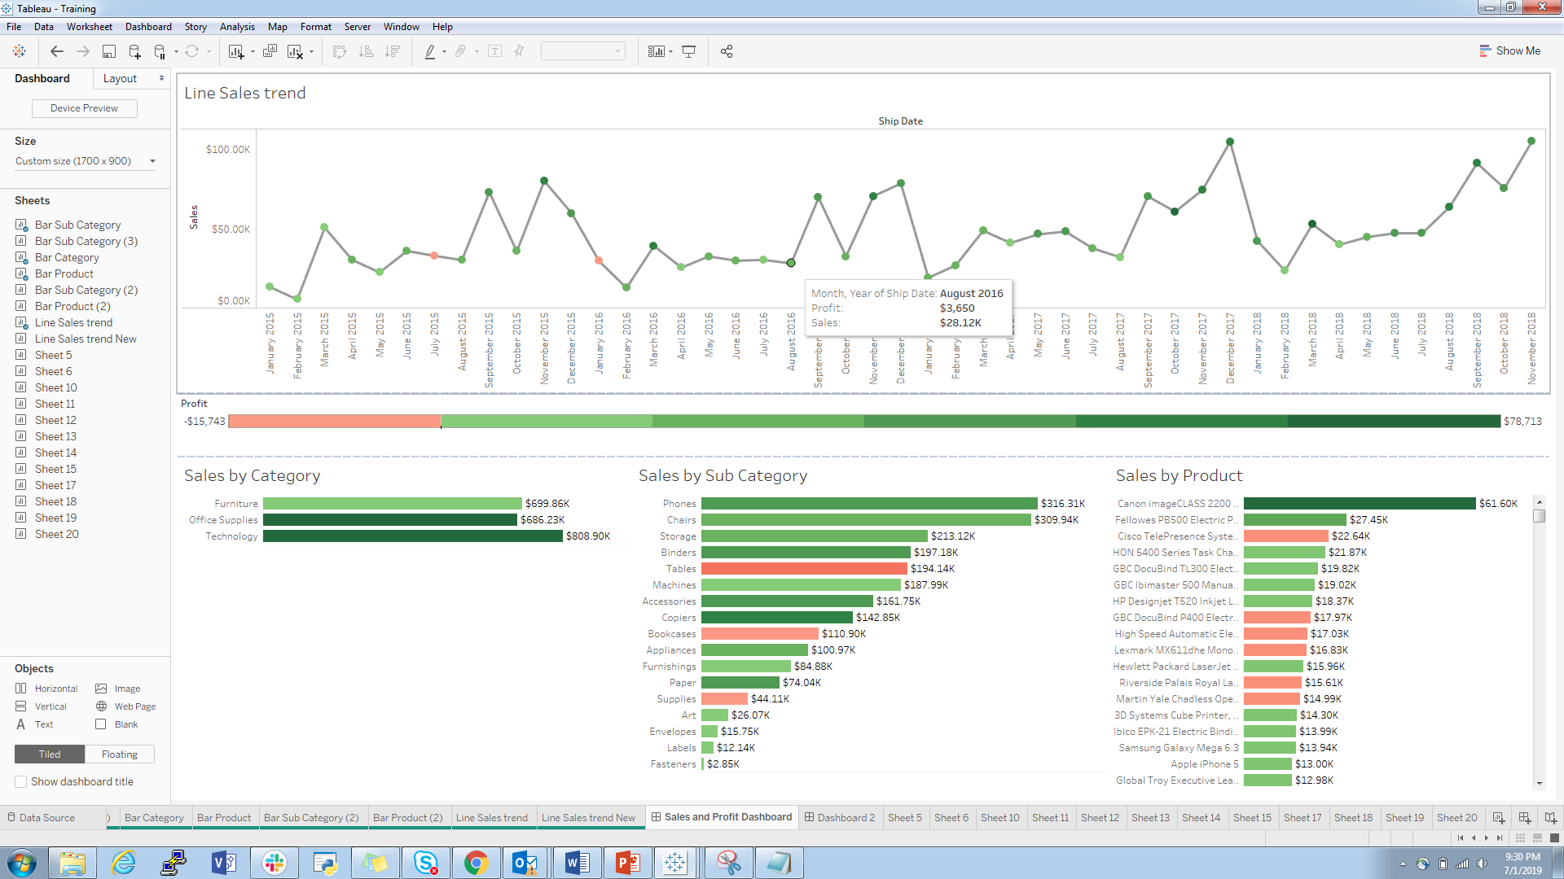
Learning Outcome – Tableau Training (Reswoods)
Dashboard Creation

Slide 16
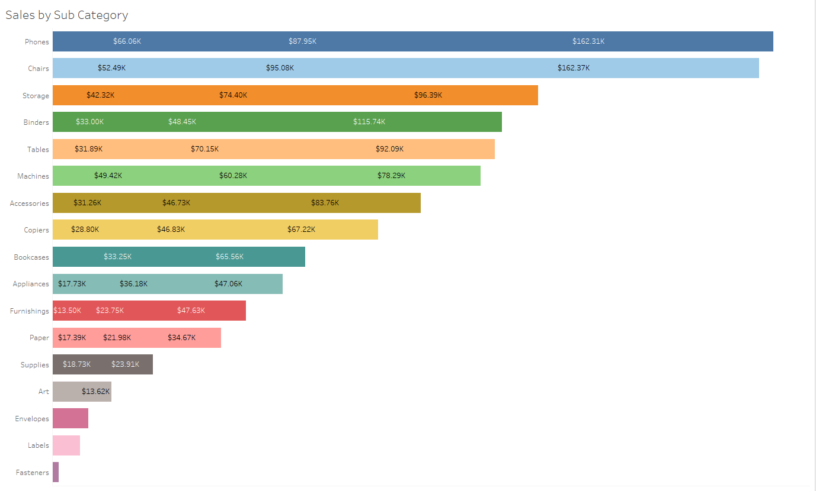
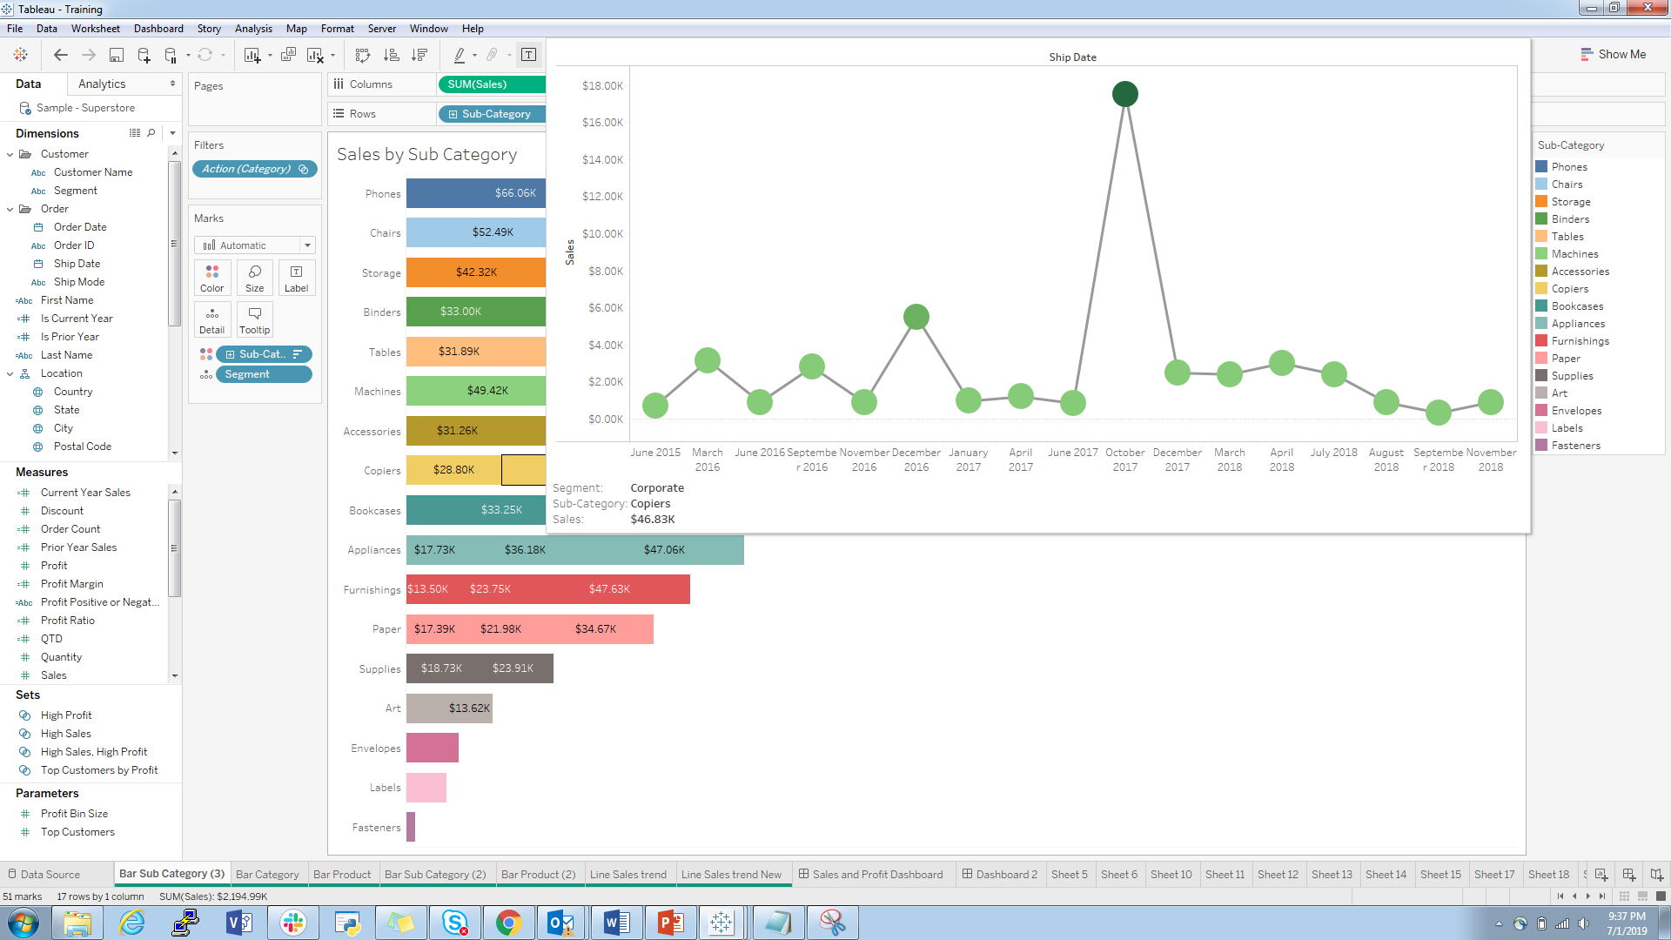
Learning Outcomes – Tableau Training
Insights From Data Visualization

Slide 17
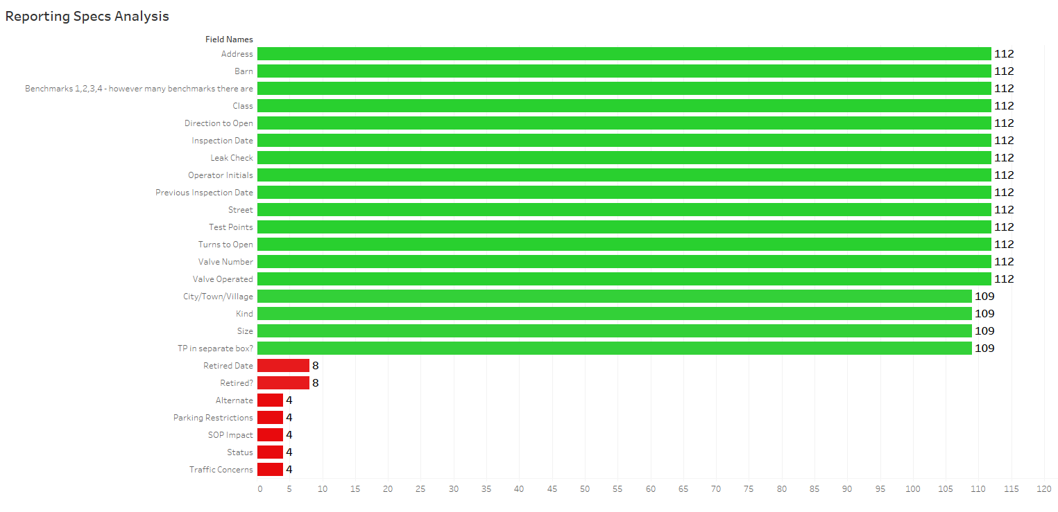
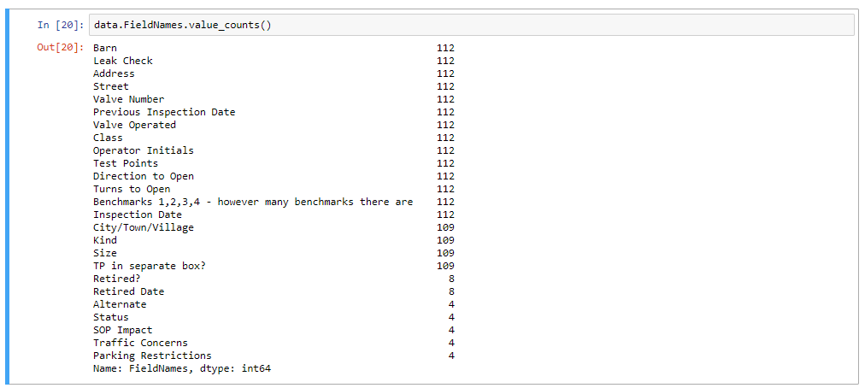
Helping Tool Preparation
Tableau
Python

Slide 18
Reporting Process Flows
Set up a start to end structure for the following :
Creating a new report
Enhancing a Report
Reporting a Production Issue
Access to Reports

Slide 19
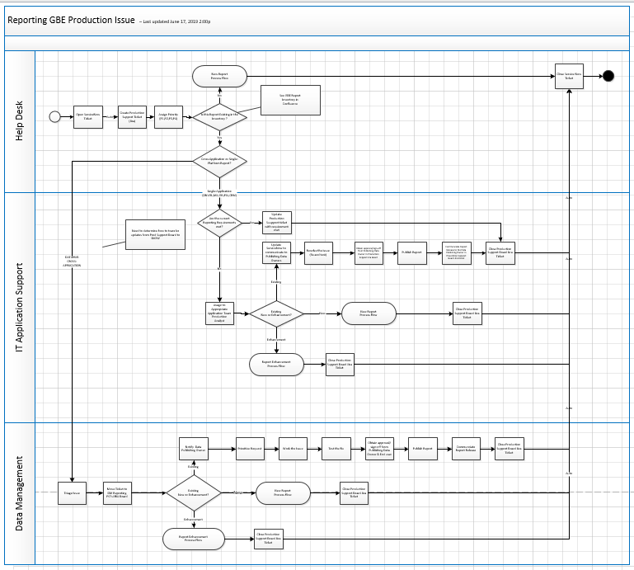
Reporting Process Flows
URL : https://nationalgrid.app.box.com/file/462192218928
for all the flows

Slide 20
Learning Outcomes
Information and practical session on Data Profiling and Data Quality Scorecards
Learned to use AgileCraft and Attlassian Jira
Understood the way an architect puts his mind into thinking about the process flows
Also got an opportunity to work in Sprints and understand the importance of Program Increments(PI)
Worked in Program Anchor(PA) which helped me understand the importance of Mocks, Dev Environments and Production
Got to Attend ,Learn and Perform hands on Git and SourceTree
Also got an opportunity to improvise my Data Visualization Skills (Tableau and PowerBI) in the form of Trainings organized by National Grid
Learned the importance of Data Accuracy while performing Data Validations.
Thumb Rule to Remember : Any Data Loss is Dangerous, therefore this step is very important after data conversions

